Slide 1
Module 2: Assess and Remediate Activate SharePoint Online Migration
Ethan Irons

Slide 2
Conditions and Terms of Use

Slide 3
How to view this presentation?
To switch to the Notes Page view:
On the ribbon, select the View tab, and then select Notes Page
To navigate through notes, use the Page Up and Page Down keys
Zoom in or zoom out, if required
In the Notes Page view, you can:
Read any supporting text—now, or after the delivery
Add notes to your copy of the presentation, if required
Take the presentation files home with you

Slide 4
Objective

Slide 5
Sections
In this lesson, you will learn:
Assessment tactics for SharePoint Online migrations
Discussion with Users
SharePoint Migration Assessment Tool (SMAT)
SharePoint Migration Identity Mapping Tool (SMIT)
Common Migration Concerns

Slide 6
Assessment Tactics

Slide 7

Assessment Tactics Overview
Assess content prior to migration.
Capture analytics on source environments.
Use manual and automated methods to perform assessment.
Microsoft provides free tools for assessing source content.
Notes:
After you have thought about how to plan your SharePoint migration and understand the new modern features of Microsoft 365 it is time to assess your current content.
Capture analytics to understand what type of content exists and how it’s being used in the environment.
There are many ways to assess your current content we will focus on the key aspects of assessing your data sources.
There are manual and automated methods to assess your current data.
Microsoft offers free tools to provide thorough analysis of your content.

Slide 8


Remediate Source Content
Delete/archive unused content.
Clean up permissions.
Redesign sites and solutions.
Great opportunity to build/enforce data governance plan or data retention policies.
Notes:
IMPORTANT: Users or Groups that don’t exist in AD or Azure AD cannot be mapped – therefore are cleaned up during migration. This is usually a good thing as the source has stale permissions and the new migration target will have clean permissions (only valid accounts that exist in the cloud).
Why is it important to remove content?
Speeds up the migration due to less content being migrated. Removing unnecessary data can provide less data exposure for data leaks or discovery.

Slide 9







Microsoft Assessment Tools
Tool | Link | Sources
SharePoint Migration Assessment Tool / SMAT | https://aka.ms/smat
SharePoint Migration Identity Mapping Tool / SMIT | https://aka.ms/smat (included with SMAT)
SharePoint Migration Tool / SPMT Select Scan-Only in the Migration Task settings. | https://aka.ms/spmt
Migration Manager Scan Feature | https://tenantname-admin.sharepoint.com/_layouts/15/online/AdminHome.aspx#/migration/fileshare
Migration Manager Scans Select Scan-Only in the Migration Task settings. | https://tenantname-admin.sharepoint.com/_layouts/15/online/AdminHome.aspx#/migration/fileshare
SP2010
SP2013
SP2016*
SP2010
SP2013
SP2016*
SP2010
SP2013
SP2016
Notes:
SharePoint Migration Assessment Tool / SMAT https://aka.ms/smat
Scans SharePoint Server 2010, 2013, 2016*
*SMAT SP2016 is best effort – it does work but was not officially designed for SP2016.
SMIT included with SMAT: SharePoint Migration Identity Mapping Tool – SMIT Included with the SMAT tool. Scans users in SharePoint Server, Active Directory and Azure AD.
SharePoint Migration Tool – SPMT
https://aka.ms/spmt
Scans SharePoint Server and file share content.
Migration Manager Scan Feature Scans files share content – provides issues and recommendations on content scanned.

Slide 10
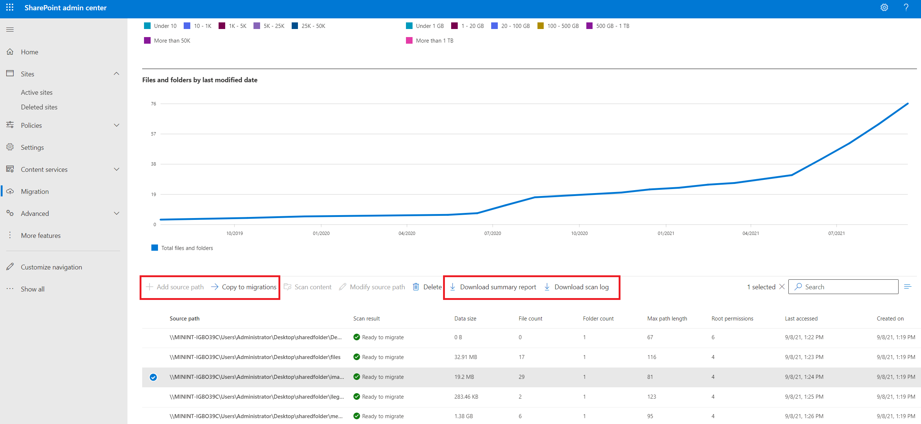
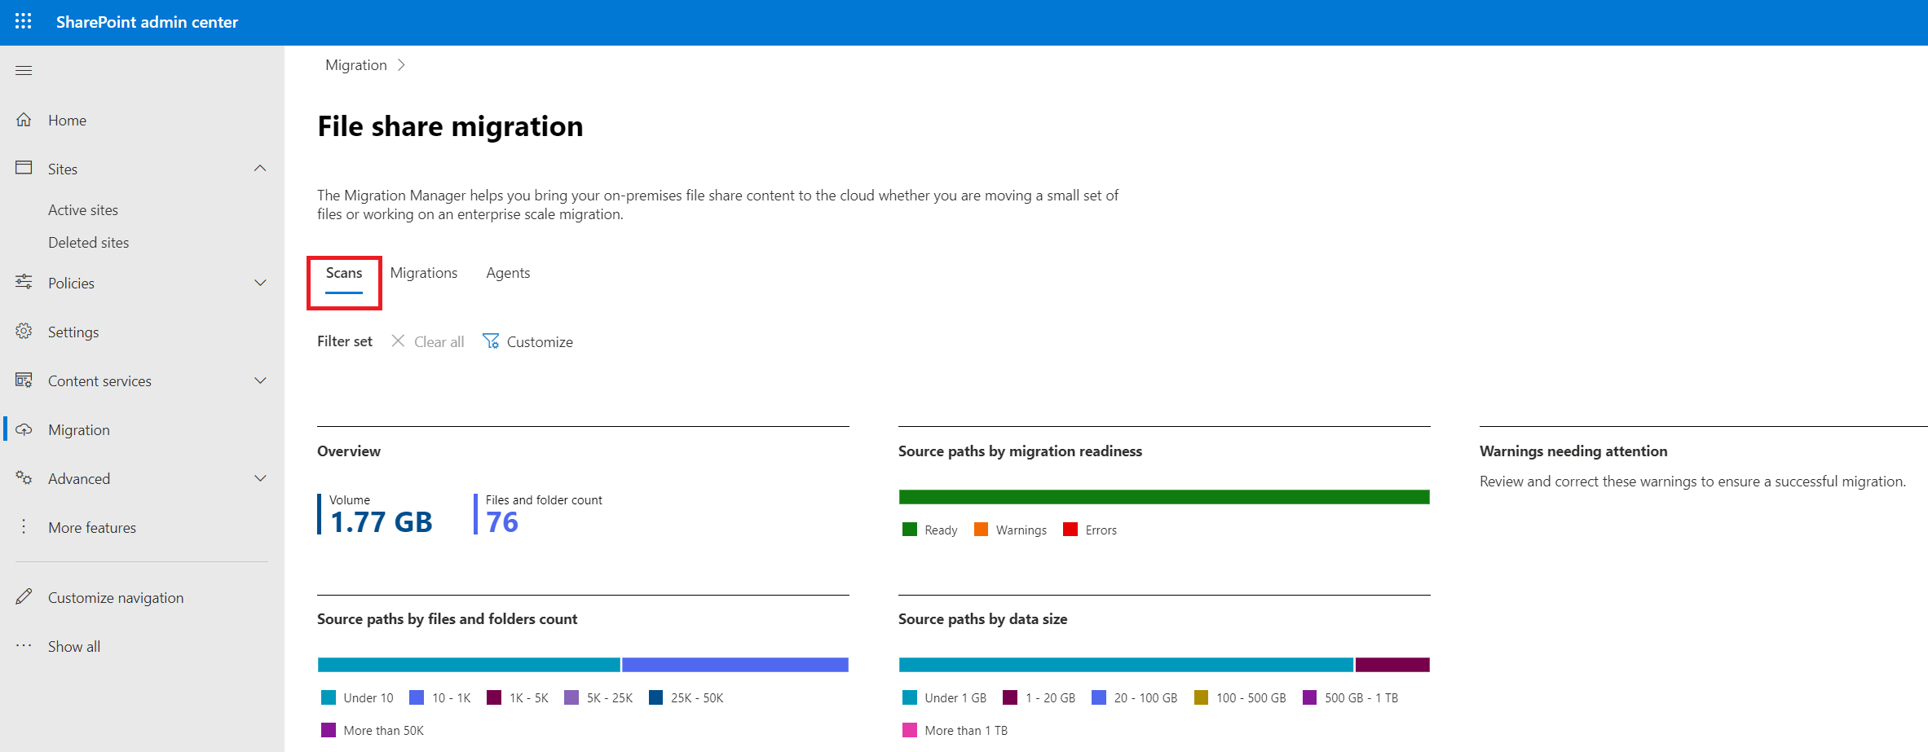
Migration Manager Scan
Notes:
Migration Manager Scan is for File Share Sources only.

Slide 11
Assess Source Content Manually
Central Administration
STSADM.exe and/or PowerShell
IIS Logs, Log Analytics, Web Analytics Module or other third-party tools
Built-in SharePoint Server analytic features:
Central Administration > Search Service Application > Usage Reports (SP2013)
Site level Popularity Trends (SP2013)
Document Library - Most Popular Items (SP2013)
Web Analytics Reports (SP2010)
Notes:
SMIT (SMIT = SMAT.exe –IdentityMapping)
Before beginning your migration, it is important that you perform an analysis of your current environment.
Performing the assessment is broken into assessing content and assessing users.
- Identity your older content and what content might be obsolete or redundant
- Identify Users

Slide 12
Assess SharePoint Server Users
Users/groups found in SharePoint Server but missing in Active Directory, were probably deleted intentionally. ☺
Migration will clean-up stale SharePoint Server permissions:
When User/Group is not found in Azure AD the permissions will be skipped during migration.
Metadata from missing users is preserved on the content: Created by, Modified by, etc.
Optionally, map missing Users/Groups to a valid accounts in Azure AD (User Mapping)
Both Migration Manager and SPMT support User Mapping.
User mapping is required if source is using non-Windows AD-based users.
Notes:
SPMT/MM performs User Mapping from Active Directory to Azure AD is automatically. User Mapping in this context would only be required when changing from a deleted account to a valid account.
If the source farm does not use Windows/Active Directory, but some other customer authentication method, you will need to use a user mapping for all accounts as SPMT will not automatically know how to map those accounts.
Scan users/groups in the SharePoint Server environment using SMIT.
Users/groups found in SharePoint Server but missing in Active Directory, were probably deleted intentionally. ☺
The migration will clean-up stale SharePoint Server permissions:
User/group is not Azure AD the permissions will be skipped during migration (aka cleaned up)
Metadata from the missing user will be preserved: Created by, Modified by, etc.
Optionally, you can map missing Users/Groups to a valid accounts in Azure AD (User Mapping)
Both Migration Manager and SPMT support User Mapping.
User mapping is required if source is using non-Windows AD-based users.

Slide 13
Common Migration Concerns

Slide 14

Common Migration Concerns Overview
Different sources will have different types of issues.
Common issues are well-documented with workarounds and solutions.
Customizations may have to be recreated to be compatible with Microsoft 365.
Notes:
There are common migration concerns and issues that you need to be aware of when assessing your data sources.
Different issues can arise when trying to migrate File Share and SharePoint Server content.
Most common issues are well documented with workarounds and solutions.
Some solutions may have to be recreated to be compatible with Microsoft 365.

Slide 15
Common Migration Concerns for File Shares
SharePoint Online has limits that may impact migration from File Shares:
Special characters in the file and folder names.
Path limits
ACL limits (Access Control List – 5000 unique ACLs)
File Sizes:
Microsoft’s Migration Tools support files up to 100GB
SharePoint Online supports files up to 250GB
NTFS permissions (No ‘Deny’ Permissions in SPO)
User experience changes (Windows Explorer vs. Browser based / OneDrive Sync client)
Notes:
File and folder name characters
Find all items in the Folders and Files report whose name contains any of the characters detailed here: Invalid file names and file types in OneDrive, OneDrive for Business, and SharePoint (https://support.office.com/en-us/article/Invalid-file-names-and-file-types-in-OneDrive-OneDrive-for-Business-and-SharePoint-64883a5d-228e-48f5-b3d2-eb39e07630fa)
Work with your migration vendor to substitute these characters in all file and folder names. Note: # % characters are supported but not enabled by default. Follow these steps to enable them: New support for # and % in SharePoint Online and OneDrive (https://techcommunity.microsoft.com/t5/microsoft-sharepoint-blog/new-support-for-and-in-sharepoint-online-and-onedrive-for/ba-p/60357)
File and folder path length
Find all items in the Folders and Files report whose Path exceeds the file path length described here: SharePoint Online limits (https://docs.microsoft.com/en-us/office365/servicedescriptions/sharepoint-online-service-description/sharepoint-online-limits )
Work with your migration vendor to reorganize your file and folder structure such that it does not exceed this limit. Splitting large drives that serve several scenarios into multiple smaller, more focused drives may help here.
Large drives and complex sharing
Scan for any drives that have a very large amount of content, or many different unique sharing permissions – this is usually a sign that the drive should be broken down into smaller, more focused sites.
Specifically, any drive that has more than 50,000 documents shared with different users must be broken up. Use Box’s Folders and Files report and Shared Links report to identify such drives.
Identify sets of content within these drives that are conceptually similar (same project area, all shared with the same users, etc).
Move these sets of content out and into new drives before starting migration.
Before beginning your migration, it is important that you perform an analysis of your current environment around the current permissions.
For complex file shares it might be required to redesign your permission strategy after the migration or in SharePoint Online and not bring over the current ACL
Only apply permissions on a child item where the required permissions are different than its parent item.
Make sure not to exceed 5000 unique ACLs on a site. It may be useful to check how many ACLs you create and warn the user prior to migration.
There is also a hard limit of 50,000 unique ACL's that will be enforced.
If you are close to reaching the 5000 limits, we recommend that the permission model be simplified on the source before migration.

Slide 16
Common Migration Concerns for SharePoint Server
Excessive file versions and large lists can result in extended migration times.
Only checked-in content will be migrated.
URL changes from on-premises to SharePoint Online.
SharePoint Online and OneDrive enforce Strict Browser File Handling mode.
Customization-related concerns covered on the following slides.
Notes:
https://docs.microsoft.com/en-us/sharepointmigration/mysites-to-onedrive-migration-guide – All Learn More links below can be found from this Migration Guide
File Versions: The more versions the longer the migration will take. Most migration tools allow you to select how many versions to migrate, or to turn off migration of versions.
Large Lists: Large lists can result in extended migration times.
Long URL’s: URL’s longer than 400 characters will be skipped.
Checked out files: Only checked-in content will be migrated. Check-in files prior to migration to avoid data loss.
URL Changes: You only have one SPO tenant, with one host URL: http://<youtenantname>.sharepoint.com – no vanity URLs. Limited # of managed paths. No explicit inclusion managed paths. Sites in SharePoint Server commonly used unique managed paths and/or unique host URLs.
Browser File Handling: SharePoint Online and OneDrive enforce Strict mode.
Files larger than 100GB: SharePoint Online supports files up to 250GB but SPMT only supports 100GB.

Slide 17
SharePoint Apps/Add-ins
Migrating SharePoint Add-ins (Apps) is not supported.
Site content is migrated, but Add-ins need to be reinstalled in SharePoint Online.
If the add-ins stored data in the SharePoint App-web, that data will be orphaned, and the add-in will be reinstalled cleanly.
Reclaim the license from the Add-in store.
Notes:
Overview
Migrating SharePoint add-ins (formerly called apps) isn't supported in the target environment. The site content will be migrated, but the add-ins will not.
As a result, once the site is migrated, the add-ins will need to be reinstalled.
If you purchased the add-in, you will need to reclaim the license from the Add-in store.
Data Migration
Site content will be migrated, but add-ins will need to be installed on the destination environment.
If any add-ins stored data in the SharePoint App-web, that data will be orphaned and the add-in will be reinstalled cleanly.
Preparing for Migration
Understand what add-ins (Apps) you have and where they are being used.
Post Migration
Site owners will need to reinstall the add-in during the user acceptance testing (UAT) process.
If there was an add-in that was purchased, the user who purchased the add-in will need to recover the license.

Slide 18
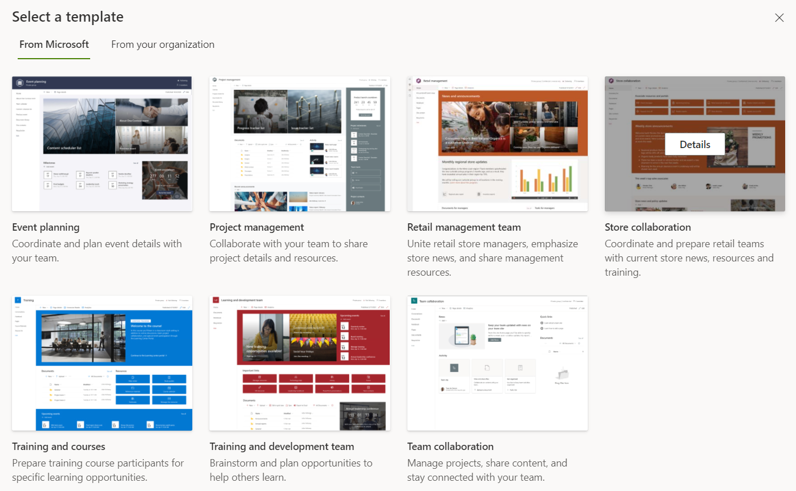
SharePoint Branding
Classic site branding does not apply to modern sites.
Site customizations are reverted to their un-customized state during migration.
Apply default themes, or create custom themes, and/or custom site designs post migration.
Utilize SharePoint Look Book and/or built-in templates →
https://lookbook.microsoft.com
Notes:
https://docs.microsoft.com/en-us/sharepoint/branding-sharepoint-online-sites-modern-experience
https://docs.microsoft.com/en-us/sharepoint/branding-sharepoint-online-sites-modern-experience

Slide 19
SharePoint Site Templates
Source sites not based on the Team Site or Personal Site template will be migrated to a new Modern Team Site (not Group connected) when using SPMT.
Content from the source environment is copied to the new Team Site.
Prepare users for any loss of features or functionality.
It is possible to pre-provision sites based on a different template (i.e. Communication Site) and use SPMT to migrate content to that site.
Notes:
https://docs.microsoft.com/en-us/sharepointmigration/migration-assessment-scan-workflow-running-solutions-2013

Slide 20
SharePoint Solutions, WSP, Full Trust Solutions
SharePoint Online does not support full trust solutions [WSP] files.
Functionality tied to full trust code will not function post migration.
How to remediate full trust code:
Determine why it was used.
Replace with native SharePoint Online functionality.
Replace with an App from the SharePoint Store with similar functionality.
Utilize the SharePoint Framework: https://aka.ms/spfx
Review Microsoft 365 Patterns and Practices: https://aka.ms/m365pnp
Notes:
https://msdn.microsoft.com/en-us/pnp_articles/office-365-development-patterns-and-practices-solution-guidance

Slide 21
SharePoint Server Features Deprecated in SPO
Business Intelligence: SharePoint Online does not support: SSRS, PowerPivot or PerformancePoint
Recreate reports and dashboards in PowerBI (or SSRS Native mode)
Classic workflows have been retired in SharePoint Online (as of 11/1/2020).
Recreate workflows in Power Automate (SPMT can migrate SP 2010 OOTB Workflows to Power Automate)
Certain aspects of InfoPath forms are not supported in SharePoint Online:
People picker fields must be updated with the new user's identity post migration.
Consider recreating the form in PowerApps.

Slide 22
Discussions with users

Slide 23
Discussions with Users Overview
Users are a great source of information on how data is being used on the source platforms.
Communicating with stakeholders and site owners is key to a successful migration.

Slide 24
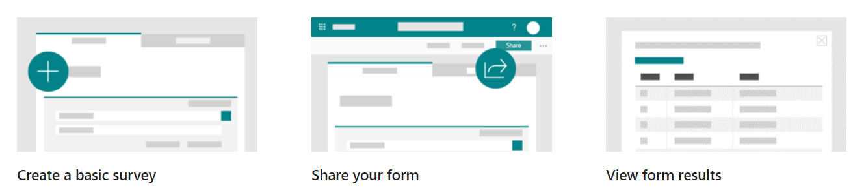
Surveys
Surveys can be a great way to start the user interactions.
Get a list of site owners and communicate with them.
Consider using Microsoft Forms:
https://www.microsoft.com/en-us/microsoft-365/online-surveys-polls-quizzes
Notes:
Ask the following types of questions:
Are you the current site owner?
Do you use your site?
What content is relevant?
Do you use any 3rd party solutions?
Do you have custom master pages?
Do you have workflows?
What can we archive?

Slide 25


Timelines and Expectations
Set timelines and expectations early.
Explain the knowns and unknowns.
Use reports.
Explain areas of concern (Custom solutions, Apps, branding, etc.)
What is expected from site owners?
Notes:
Start early and set your expectations and timeline with customers
Make sure you explain to them the knows and unknows
Use reports to help customers better understand what they have
Explain the areas of concern (Custom solutions, branding, large files)
What is expected from them as site owners
Are they the right contact person? If not, who is?
What you need them to do?
Clean up data
Do UAT testing
Communication with site users
How to escalate issues
What are the timelines or deadlines
When Clean-up is needed by
When UAT testing is needed by
When issues need to be identified by
When the site will go live

Slide 26
SharePoint Migration Assessment Tool (SMAT)

Slide 27
SMAT Overview
SMAT is a free command-line tool that scans SharePoint Server environments.
Designed to run without impacting the environment.
Reports progress in a console window.
Provides summary and detailed reports on the content that could impact migration to SharePoint Online.

Slide 28
SMAT Modes
Assessment (SMAT)
Default mode
Scans the SharePoint farm for known migration issues.
Identity Mapping (SMIT)
Generates a report of users across SharePoint Server, Active Directory and Azure AD.

Slide 29
SMAT Prerequisites
Supported Operating Systems: Windows Server 2008, 2012
Supported versions of SharePoint Server: 2010, 2013, 2016
English Language Only
Download https://aka.ms/smat and extract the ZIP
SMAT tool permission requirements:
Member of Farm Administrators Group
Read access to all Web Applications
Explicit Full Control permissions to the User Profile Service Application
Pre-flight validation ensures the account has enough permissions prior to scanning the environment

Slide 30
SMAT Assessment Scans
Sites
Customizations
Services/Farm
List Library
Large Sites
Locked Sites
Publishing Sites
Alerts
External Lists
Email Enabled Lists
IRM Enabled Lists
Large View Lists
Large Lists
Unsupported Site Templates
Site Template Language
Master Pages
Publishing Pages
Sandbox Solutions
Apps
Customized Pages
InfoPath Forms: Forms with SOAP Calls, Unsupported Data Connection, Managed Code
Full Trust Code
Farm, Web Application, and Site Scoped Features
Content Types
Event Receivers
Custom Page Layouts and Web Parts
Secure Store
Business Data Connectivity Services (BCS)
Custom Profile Property Mappings
Long OneDrive for Business URLs
Web Application Policies
Browser File Handling
Checked Out Files
Custom Permission Levels
File Versions
Large Excel Files (Over 10MB) – Will prompt to open in Excel
Managed Metadata Columns
SharePoint 2010 Workflow Associations/running workflows
SharePoint 2013 Workflow Associations/running workflows
Custom Fields
List Templates

Slide 31
SMAT Executables
SMAT.exe
Launcher program that determines your intentions based on the parameters passed in and then loading the appropriate application to do the work requested
SMAT2010.exe
Performs assessment on SharePoint 2010 environments
SMAT2013.exe
Performs assessment on SharePoint 2013/2016 environments
SMIT.exe
Performs identity mapping work for SharePoint 2010, 2013, 2016 environments
Notes:
More Details - https://docs.microsoft.com/en-us/sharepointmigration/overview-of-the-sharepoint-migration-assessment-tool#execution

Slide 32
SharePoint Migration Assessment Tool: Configuration Settings

Slide 33
SMAT Configuration Settings Overview
The SMAT tool can allow for customization based on what needs to be identified or how the tool should perform.
The customization allows admins to:
Change output of logs
Schedule the scan
Exclude sites
Exclude scans

Slide 34
SMAT: Remove Sites From Scanning
There are multiple ways to exclude sites from the scan.
Removing unwanted sites reduces overall execution time.
Open the SkipSitesList.csv file found in the same directory as the smat.exe.
Add one entry per row:
URL Type | Behavior
http://team.contoso.com/sites/projecta | Excludes one site collection.
/personal/ | Excludes any site collection that has /personal/ in the site collection URL
http://portal.tailspintoys.com | Excludes any URL under http://portal.tailspintoys.com
Notes:
More Details - https://docs.microsoft.com/en-us/sharepointmigration/overview-of-the-sharepoint-migration-assessment-tool#config-files
We also do this in Scenario 2.1.2

Slide 35
SMAT: Modify Scans
Open the ScanDef.json file found in the same directory as the smat.exe.
Enable or disable individual scans.
Disabling unwanted scans reduces overall execution time.
Confirms what versions of SharePoint Server the scan applies to.
Allows modification of properties on scans.
Disable Rules | Supported Versions | Properties
{ "Name": "Alerts", "Type": "AlertsScanner", "SupportedVersions": [ "2010", "2013", "2016" ], "ReportCategoryType": "SPSite", "Enabled": false } | { "Name": "Apps", "Type": "AppsScanner", "SupportedVersions": [ "2013", "2016" ], "ReportCategoryType": "SPSite", "Enabled": true } | { "Name": "SiteTemplateLanguage", "Type": "SiteTemplateLanguageScanner", "SupportedVersions": [ "2010", "2013", "2016" ], "Property": { "ExcludedLanguages": "" }, "ReportCategoryType": "SPSite", "Enabled": true }
Notes:
More Details - https://docs.microsoft.com/en-us/sharepointmigration/overview-of-the-sharepoint-migration-assessment-tool#config-files
We also do this in Scenario 2.1.2

Slide 36
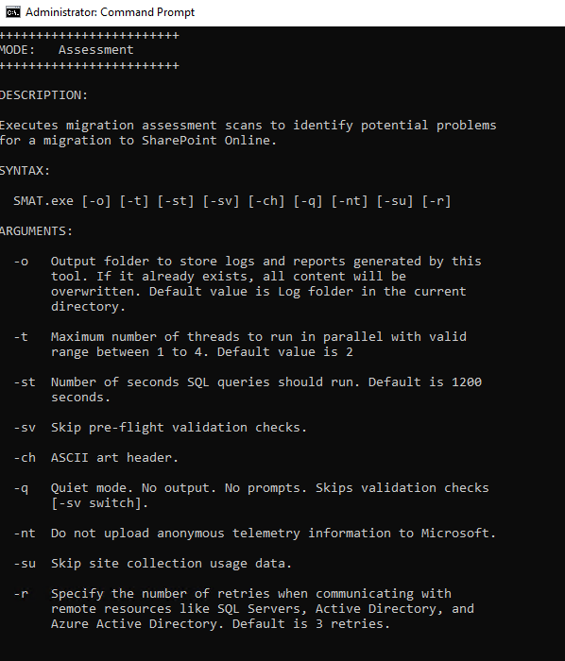
SMAT: Configuring the Run Experience
Run SMAT.exe /help - List of switches
“-o” – Output location for logs
“-t” – Number of threads in parallel (1-4 default is 2)
“-q” – Quiet mode
“-su” – Skip site collection usage
Automating Assessment
Notes:
Changing the Number of Threads in parallel can have an impact on the SharePoint Farm.
You can also schedule this to run
Automating assessment
If you have the need to schedule the assessment process, you can do so by running the specific EXE. For example, if you want to setup a scheduled task on a SharePoint 2010 farm for assessment, you would point the scheduled task to SMAT2010.exe. If you wanted to write a PowerShell script that ran assessment on SharePoint 2013/2016, you would point the script to SMAT2013.exe.
Any scripting scenario will need to use the -q switch to run the EXE in quiet mode. This mode does not output anything to the console and avoids anything that would prompt the operator for input.

Slide 37
SharePoint Migration Assessment Tool: Logs

Slide 38
SMAT: Logs Overview
The SMAT tool provides logs as it is scanning to identify items that may require investigation.
Content that cannot be scanned will be listed in the logs such are certain farm components.
Scans can run for an extended period due to system dependencies.

Slide 39
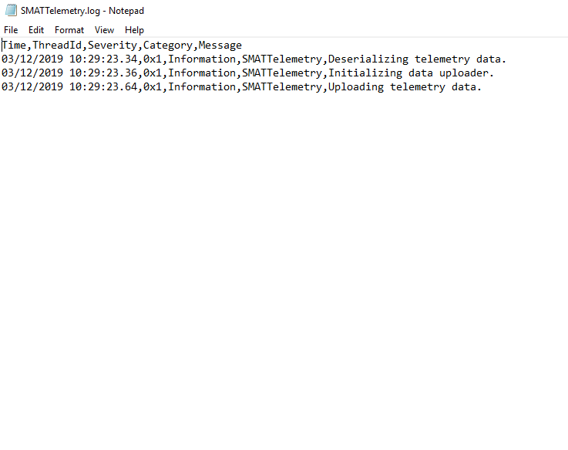
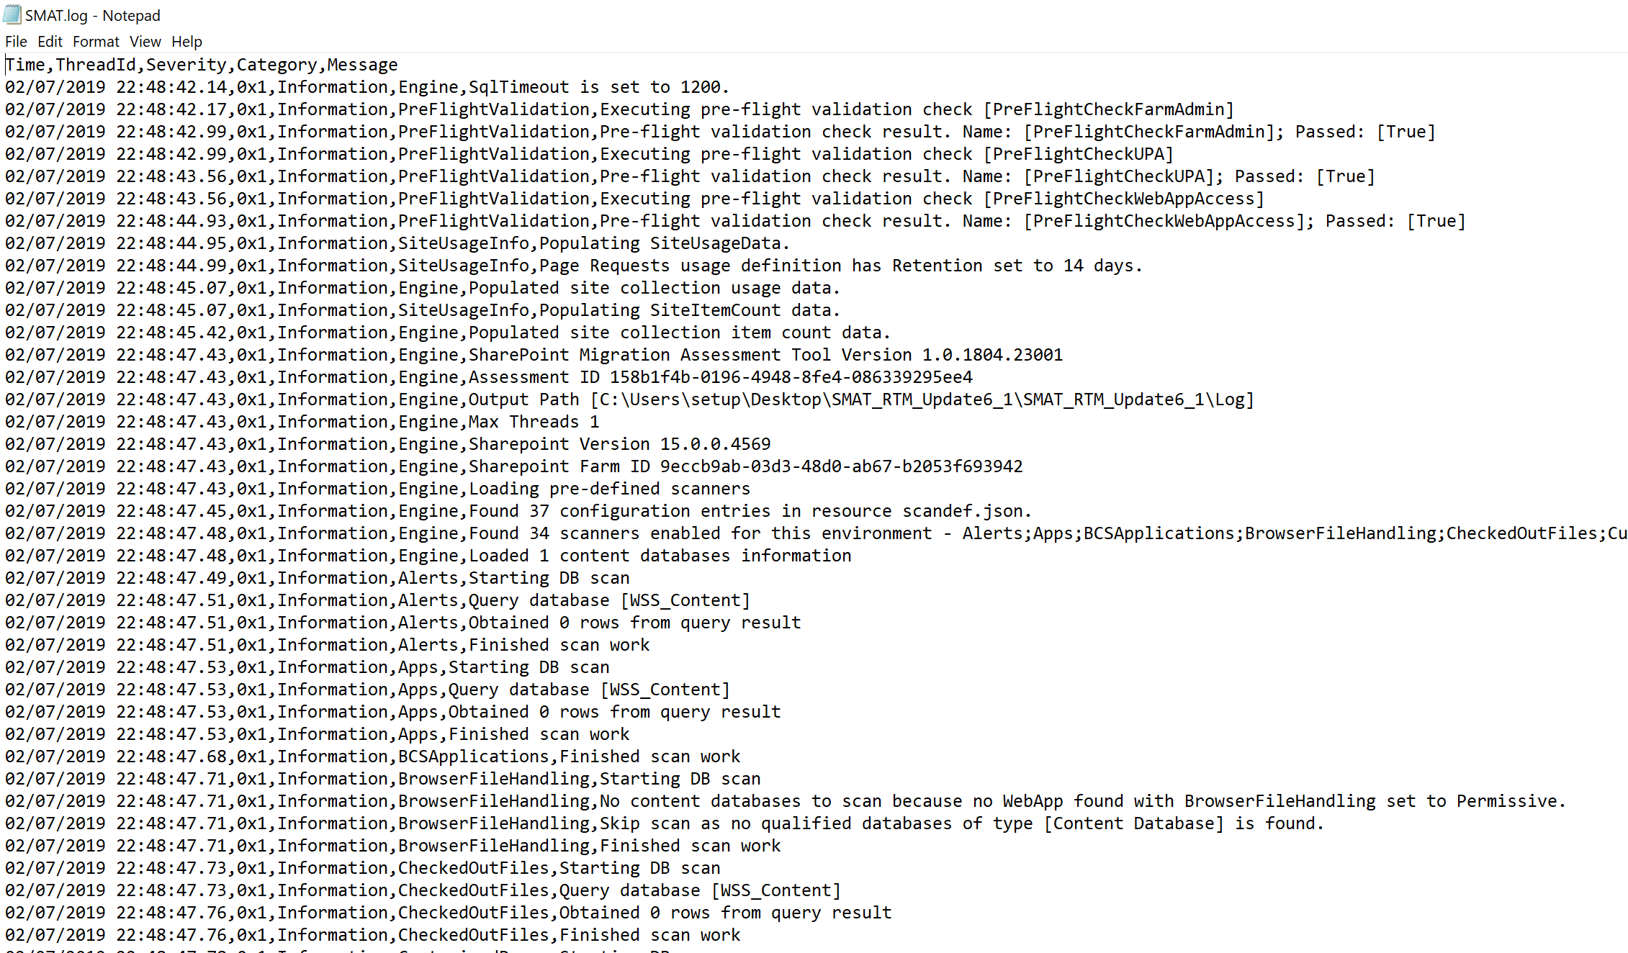
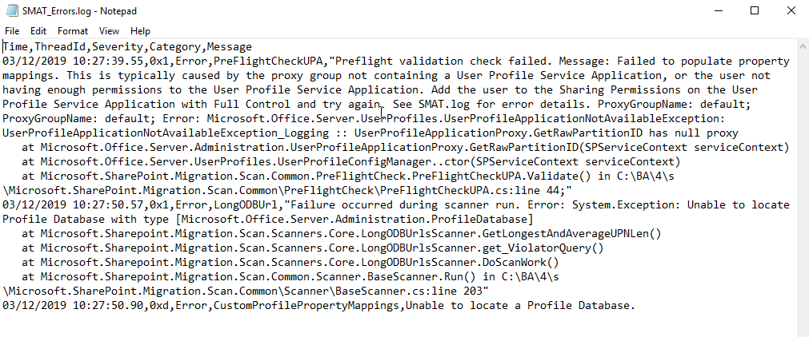
SMAT Logs
SMAT_Errors.log
SMATTelemetry.log
SMAT.log
\Log Folder
Notes:
SMAT.log - This file contains all the logging from the tool execution. This will contain 3 levels of logging. Information, Warning, and Errors. Information help track down progress and troubleshooting issues. Warnings are typically expected error conditions. Errors are unexpected conditions that our tooling was unable to determine if they will be a blocker to moving forward. These need to be looked at.
SMAT_Errors.log - This contains only the Error events. If this file is missing after the tooling completes, it indicates there were no errors found.
SMATTelemetry.log - This contains logging for the telemetry upload tooling. Any issues in here will not impact generating your reports.
https://docs.microsoft.com/en-us/sharepointmigration/overview-of-the-sharepoint-migration-assessment-tool#log-files
We also do this in Scenario 2.1.5

Slide 40
SharePoint Migration Assessment Tool: Reports

Slide 41
SMAT: Reports Overview
Generates numerous CSV reports.
The SummaryReport.csv aggregates issue counts.
More detailed reports are provided to give issue-level information.
Each scan creates a detailed report.
There is a corresponding roadmap (knowledge base) per scan that provides detailed guidance.
Optionally, use a tool to merge the individual SMAT reports into a combined report. (This can be helpful for larger environments).

Slide 42
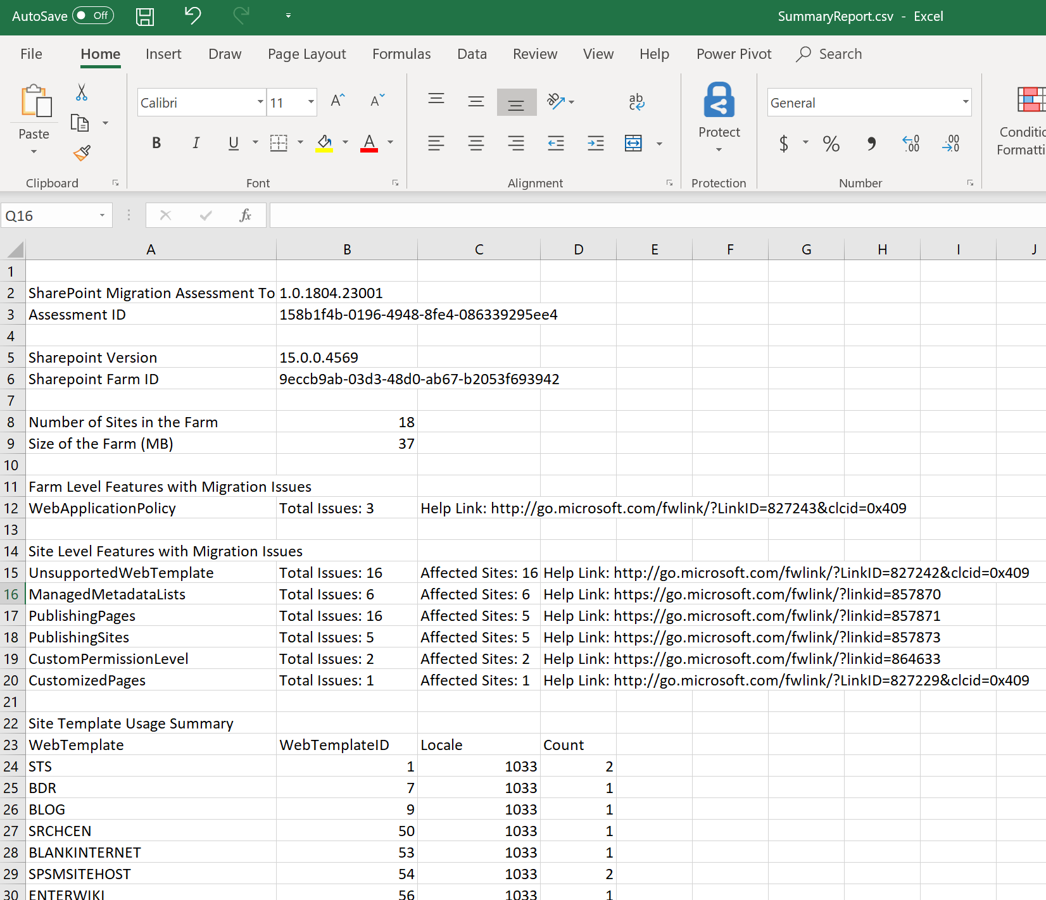
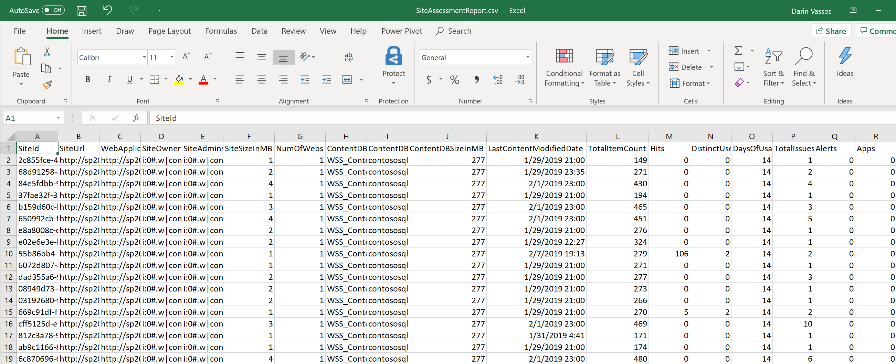
SMAT Reports
SummaryReport.csv
SiteAssessmentReport.csv
Individual Scanner Reports
Notes:
Three main areas we look for logs from SMAT
SummaryReport.csv – High level breakdown of the farm.
SiteAssessmentReport.csv – Breakdown by site collection of items identified as possible issues.
Individual Scanner Reports - Detailed information about each issues that arose during the assessment of your data while running the SharePoint Migration Assessment Tool (SMAT).
We also do this in Scenario 2.1.5

Slide 43
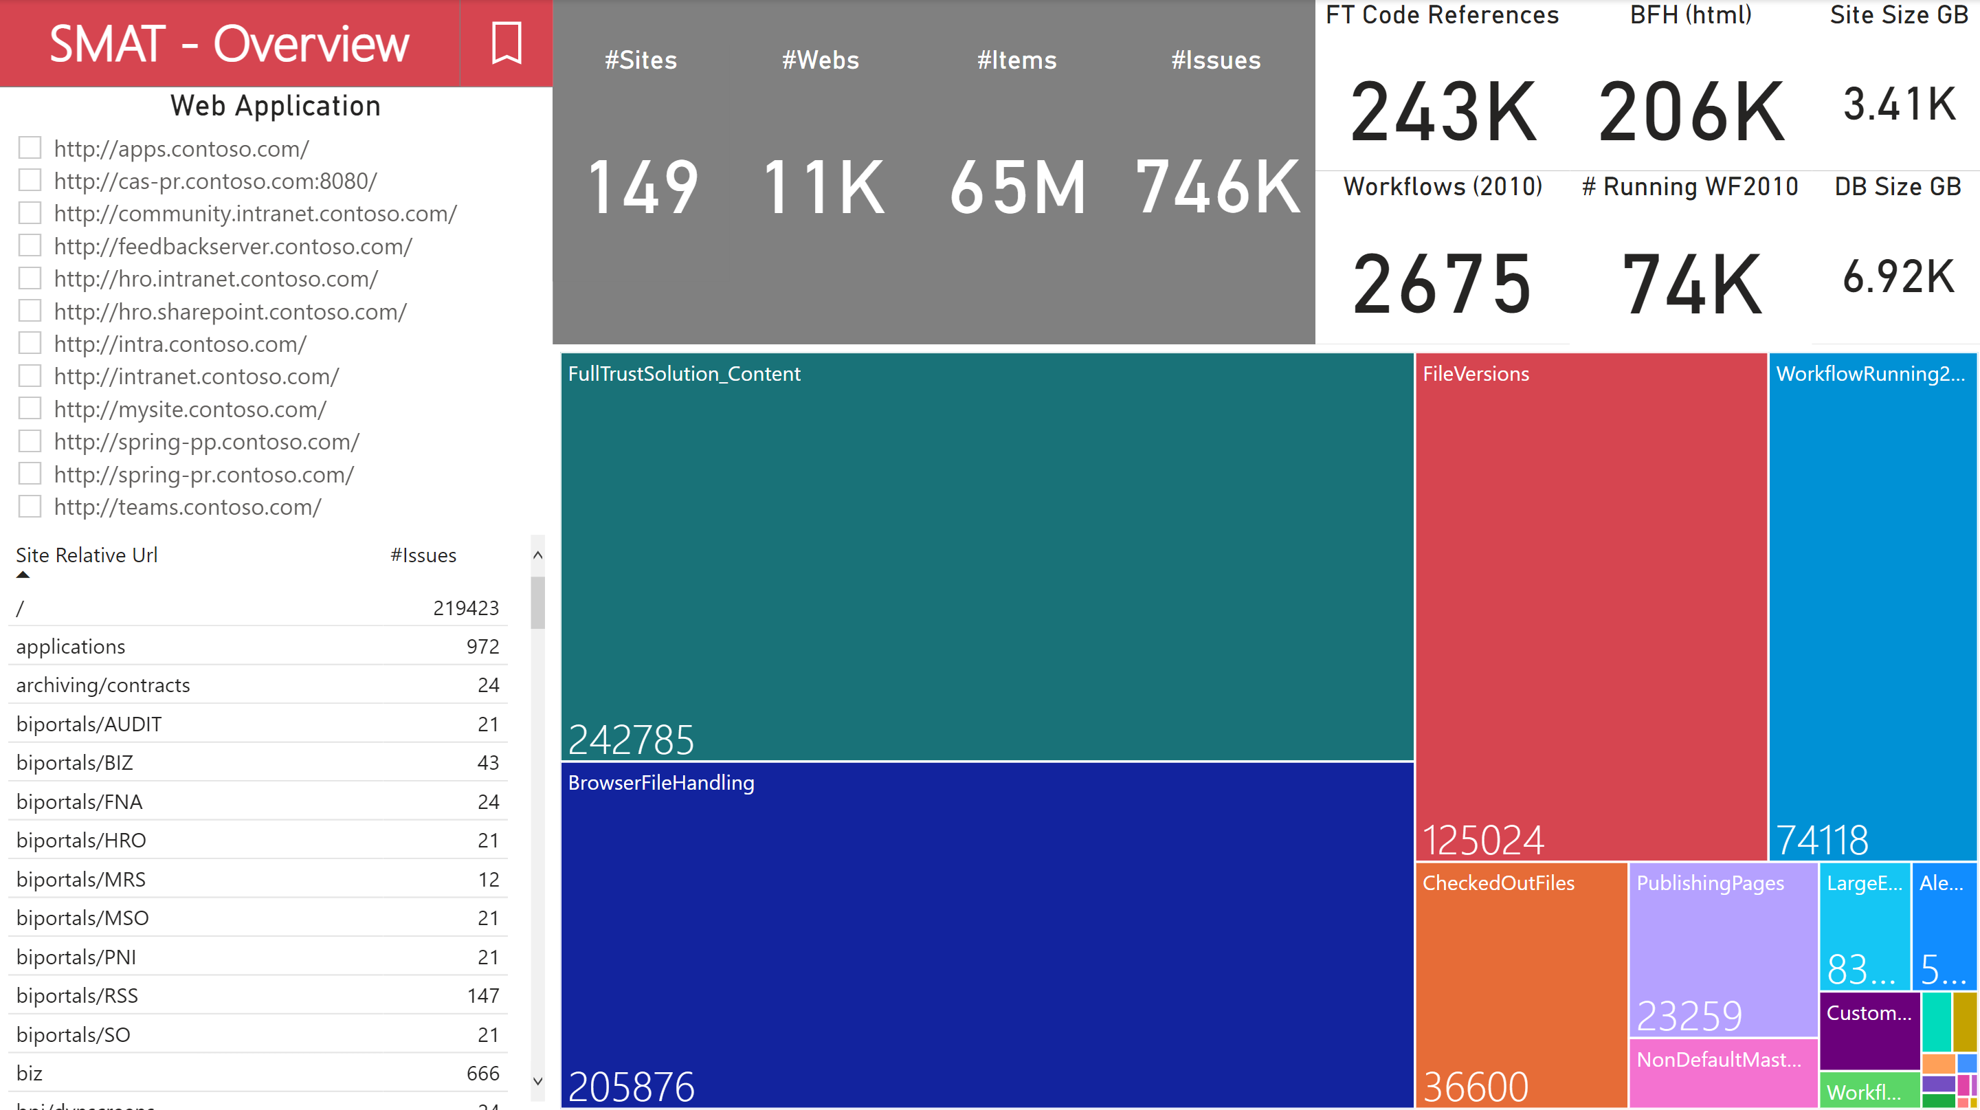
Import SMAT Reports in PowerBI Desktop
Notes:
Optional: Review SMAT reports in PowerBI desktop for more insights.
Important: Custom PowerBI Desktop package is included as part of Scenario 2.2

Slide 44
SMAT Scan Reports Roadmap
For a full list of items scanned and remediations look at the remediation roadmap: https://aka.ms/sharepoint_migration
The roadmap includes the following information about each migration assessment scan:
Why it was identified
Data Migration information
Preparing for Migration
Post Migration
Details on the Scan Result Reports

Slide 45
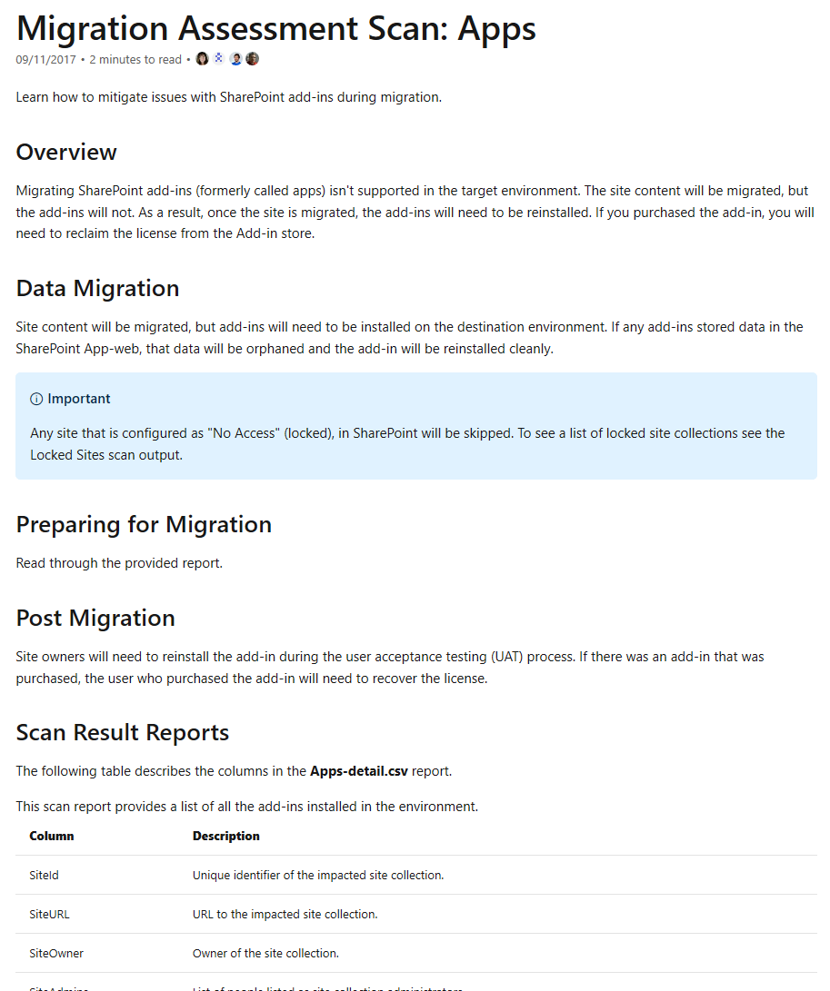
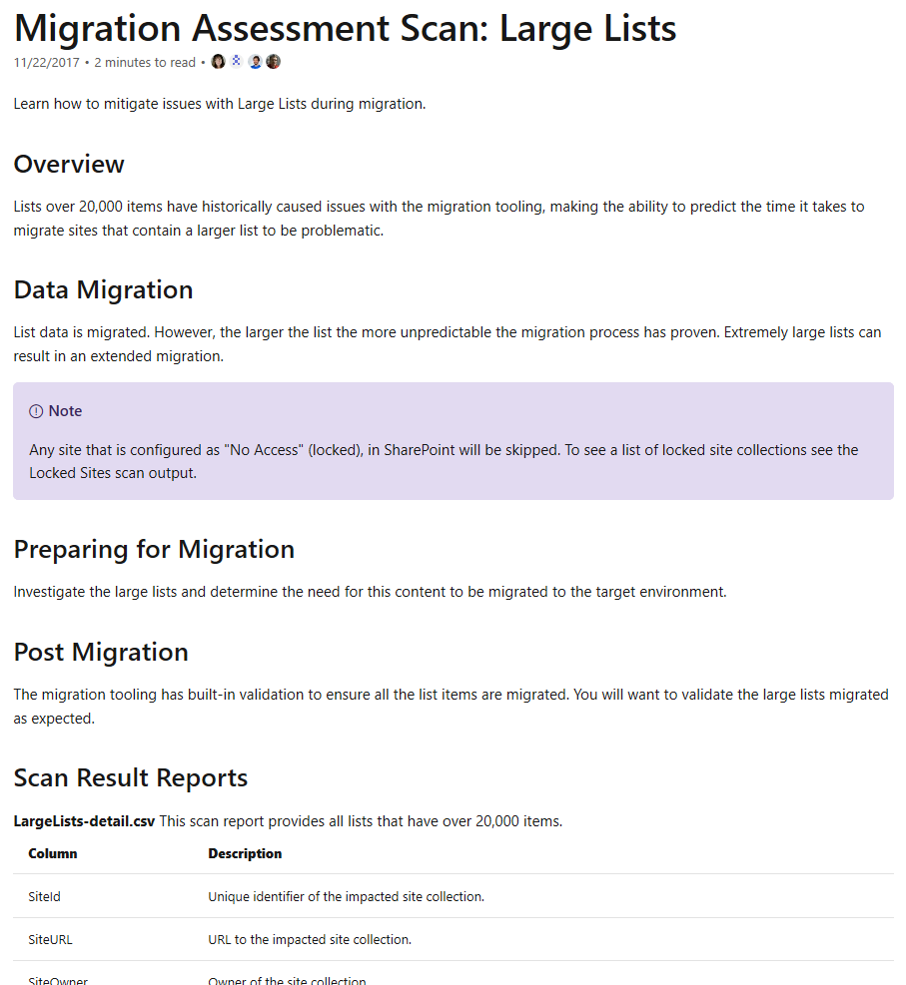
SMAT Scan Report Roadmap - Examples
Notes:
https://docs.microsoft.com/en-us/sharepointmigration/sharepoint-migration-assessment-toolscan-reports-roadmap

Slide 46
SharePoint Migration Identity Mapping Tool (SMIT)
Notes:
S.M.I.T
- We'll first discuss How it works; and then get into How to use it

Slide 47
SMIT Overview
Part of the SMAT tool.
Maps identities from the SharePoint on-premises environment to the target-state Azure AD.
Performs verification that all required users/groups are synchronized to Azure AD – which is a prerequisite of migration to SharePoint Online.
Notes:
The SharePoint Identity Mapping tool (SMIT) is a feature of the SharePoint Migration Assessment Tool (SMAT).
Identity Mapping is the process of mapping identities from the SharePoint on-premises environment to the target-state Azure AD.
The tool performs verification that all needed users and groups are synchronized to Azure AD so that permissions are mapped during migration.
Missing Users or Groups need to be remediated by either syncing them to Azure AD, ignoring them, or mapping them before migration.

Slide 48
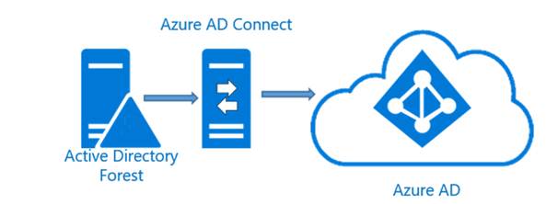
SMIT: What is Scanned
The SharePoint Migration Identity Management Tool performs identity mapping by running three different scans:
SharePoint Identity Scan
Active Directory Identity Scan
Azure Active Directory Identity Scan
Notes:
SharePoint Identity Scan
Responsible for finding users and groups that are listed as active in the SharePoint farm being scanned.
The result of this scan is a set of distinct identities that have permissions in the source SharePoint environment.
Reads each SharePoint Content Database and if the User Profile Service is available, it will gather the email and My Site information related to the identity.
Required for identity mapping as the data located in SharePoint is used for the resultant identity scans.
Active Directory Identity Scan
Discover the Active Directory Forests
We find the forest the SharePoint server is connected to
Enumerate trusts to locate all the trusted Forests
This process may prompt for credentials
The tool will cache the credentials entered for the current execution
Lookup identities in Active Directory
Use the cached credentials to lookup users/groups in Active Directory using the Security Identifier [SID]
This information is not 100% needed for identity mapping.
Useful if identities flagged as NoMatch or PartialMatch
Example, you have a user that is showing as Active in SharePoint but is Disabled in Active Directory. Seeing this user with NoMatch is expected as the user is not likely to be synced to Azure Active Directory.
Azure Active Directory Identity Scan
Scan will look up identities found in the source SharePoint environment in the Azure Active Directory
Uses Azure Active Directory Authentication Libraries (ADAL) to authenticate the operator to Azure Active Directory. This requires consent for the application to read the Azure Active Directory.
The tool will perform a pre-flight validation check, which involves authenticating to Azure. This enables the operator to avoid running a long scan process if all the prerequisites have not been met.

Slide 49
SMIT: Identifying Matching Users and Groups
When performing look-ups, this is the pattern used for matching:
ExactMatch: Source Identity is a Windows User or Group with a Security Identifier [SID]. The target is the OnPremisesSecurityIdentifier in Azure AD.
Non-Windows accounts will never be able to have an ExactMatch.
PartialMatch: Source identity claim value equals the UserPrincipalName or Mail value in Azure Active Directory. Source Identity Display Name equals the Display Name in Azure AD.
NoMatch: Unable to perform neither ExactMatch or PartialMatch.

Slide 50
How to Use the SMIT Tool
Launch SMAT Tool
Provide consent to allow the tool to access your Azure Active Directory.
Run SMIT
Review SMIT Logs
Review SMIT Reports
Notes:
Launch SMAT Tool (SMIT included in SMAT tool)
Provide consent to allow the tool to access your Azure Active Directory.
You need to consent to allow assessment tool to read your Azure AD directory
Run SMIT using one of two consent options:
SMAT.exe –ConfigureIdentityMapping
Or
SMAT.exe –GenerateIdentityMapping
Review SMIT Logs and Reports
https://docs.microsoft.com/en-us/sharepointmigration/sharepoint-migration-identity-mapping-tool#process

Slide 51
SMIT: Application Consent
Consent to allow the assessment tool to read the Azure AD directory is required.
There are two options to do this:
Allow anyone in the tenant to run SMIT to perform identity mapping for migration in Microsoft 365.
Run the assessment tool as a user with Azure Tenant Admin rights.
Application consent can be removed after assessment is complete from the Azure Tenant.
Once removed it will be necessary to provide consent the next time the identity mapping process is run.
Notes:
Option 1 - https://docs.microsoft.com/en-us/sharepointmigration/sharepoint-migration-identity-mapping-tool#consent-to-read-directory-data
Allow anyone in the tenant to run SMIT to perform identity mapping for migration in Microsoft 365
Connects SMIT tool to the tenant's Enterprise Applications section.
Run: SMAT.exe -ConfigureIdentityMapping
Enter your Azure tenant admin credentials. When prompted for consent, click Accept.
A SharePoint admin is now able to run the identity mapping process.
Option 2
Run the assessment tool as a user with Azure Tenant Admin rights.
Run: SMAT.exe -GenerateIdentityMapping
When prompted with the Azure logon dialog, enter your Azure Tenant Admin credentials.
When prompted for consent, click Accept. This will only consent the app for the logon provided
Remove - https://docs.microsoft.com/en-us/sharepointmigration/sharepoint-migration-identity-mapping-tool#remove-consent
Follow the steps below to remove consent for the SharePoint Online Identity Mapping Application from your Azure Tenant.
Once these steps have been performed, it will be necessary to provide consent the next time the identity mapping process is run.
Browse https://portal.azure.com
Logon as a tenant admin.
Locate Enterprise applications.
Click All applications.
Select SharePoint Online Identity Mapping Tool in the list of applications and then click Delete.
More information about Azure Application consent - https://docs.microsoft.com/en-us/azure/active-directory/manage-apps/configure-user-consent and Understanding Azure AD application consent (https://docs.microsoft.com/en-us/azure/active-directory/develop/application-consent-experience)
Applications can integrate with the Microsoft Identity platform to allow users to sign in using their work or school account in Azure Active Directory (Azure AD), and to access your organization's data to deliver rich data-driven experiences. Different permissions allow the application different level of access to your users' and your organization's data.
By default, users can consent to applications accessing your organization's data, although only for some permissions. For example, by default a user can consent to allow an app to access their own mailbox or the Teams conversations for a team the user owns, but cannot consent to allow an app unattended access to read and write to all SharePoint sites in your organization. While allowing users to consent by themselves does allow users to easily acquire useful applications that integrate with Microsoft 365, Azure and other services, it can represent a risk if not used and monitored carefully.

Slide 52
SharePoint Migration Identity Mapping Tool: Reports

Slide 53
SMIT: Reports Overview
Open the CSV report in Excel (for sorting/filtering).
SMIT report will identify conditions when specific users/groups have access (permissions) to SharePoint but do not exist in the target Azure AD tenant.
Missing users/groups will need to be remediated by either syncing them to Azure AD, ignoring them, or mapping them before migration.

Slide 54
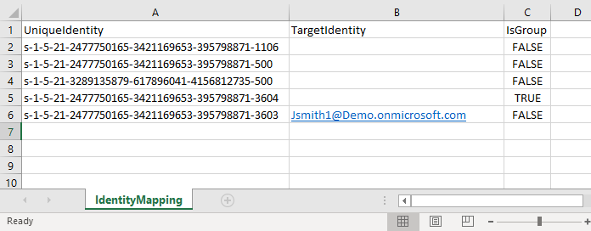
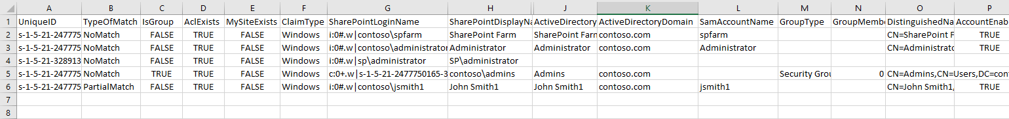
SMIT: Reports
FullIdentityReport.csv
IdentityMapping.csv
Notes:
FullIdentitiyReport.csv - https://docs.microsoft.com/en-us/sharepointmigration/sharepoint-migration-identity-mapping-tool#fullidentityreportcsv
The FullIdentityReport.csv contains a dump of all the identity data we discovered about the users and groups that were listed as active in the SharePoint environment. The purpose of this report is to understand all the users and groups that have access to SharePoint and whether those identities have an associated Azure AD identity.
If the identity is not found in Active Directory, the Active Directory fields will be empty. The FoundInAD field will be false and ReasonNotFoundInAD will contain a reason code.
If the identity was not found in Azure Active Directory, the Azure Active Directory fields will be empty. The FoundInAzureAD field will be false and ReasonNotFoundInAzureAD will contain a reason code.
IdentityMapping.csv - https://docs.microsoft.com/en-us/sharepointmigration/sharepoint-migration-identity-mapping-tool#identitymappingcsv
IdentityMapping.csv is a pre-generated identity mapping file. All identities are represented in the file. Unmapped identities will have blank values for TargetIdentity.

Slide 55

Microsoft Corp – End of Presentation

Slide 56
Scenario 2.1 Assess a SharePoint Server farm for Migration to SharePoint Online

Slide 57
Scenario 2.2 Analyze SMAT results using PowerBI desktop

